Slide 1
GENDER CLASSIFICATION
By Mashari & Sohaib

Slide 2
TABLE OF CONTENTS
01.
02.
03.
INTRODUCTION
Data
Relations
04.
05.
06.
Baseline model
Model Selection
Demo Website

Slide 3
01.
INTRODUCTION

Slide 4


INTRODUCTION
PROBLEM
SOLUTION
The police have the witness description of the criminal, but they do not know the GENDER.
We will develop a classification model to predict the gender.

Slide 5
02.
DATA EXPLORE

Slide 6





Data columns
LONG HAIR
FORHEAD WIDTH
FORHEAD HEIGHT
NOSE WIDE
LIPS THIN
NOSE LONG
Zero or One
Width in CM
Height in CM
Zero or One
Zero or One
Zero or One

Slide 7
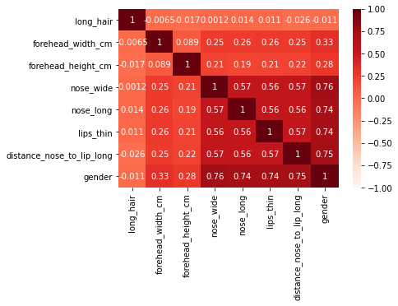
DATA RELATIONS
HEIGHST
LOWEST
NOSE_WIDE
LONG_HAIR

Slide 8
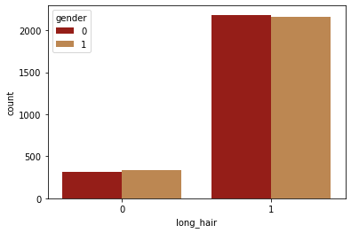
LONG HAIR

Slide 9
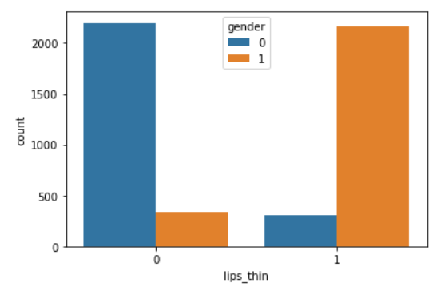
LIPS THIN

Slide 10
03.
BASELINE MODEL

Slide 11
BASLINE MODELS
Logistic Regression
C=300
Score = 96%
Random Forest
n_estimators=1000
Score = 96%
KNN
Nneighbors=5
Score = 96%

Slide 12
04.
Selecting MODEL

Slide 13
GridSearchCV
Logistic Regression | KNN | Random Forest | SVM
C: 1 - 10000 | Nneighbors: 1 - 10 | n_estimators: 1 - 1000 | Kernal: linear, poly, rbf, sigmoid
Best C = 1001 | Best N = 5 | Best N = 201 | Best Kernal = rbf
Test Score = 96.1% | Test Score = 96.5% | Test Score = 96.1% | Test Score = 96.3%

Slide 14
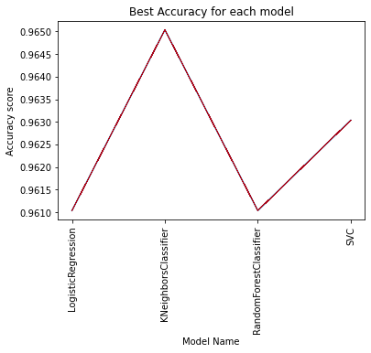
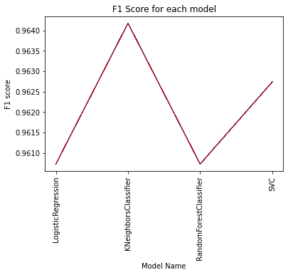
COMPARE MODELS
Accuracy
F1 Score

Slide 15
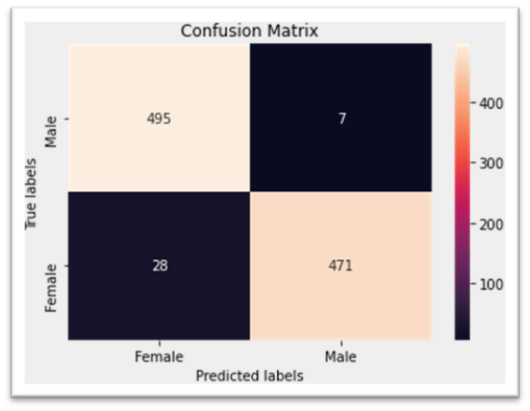

KNN MODEL
MALE
FEMALE
PRECISION= 99%
RECALL= 94%
F1 = 96%
PRECISION= 95%
RECALL= 99%
F1 = 97%
97%

Slide 16
05.
CONCLUSIONS

Slide 17
CONCLUSIONS
We get a good result in predicted the gender of criminal after receiving the description from the witness. The model will help the police to reduce the search area. and we have achieve a very good accuracy 97% in the best model!.

Slide 18
THANKS!
Do you have any questions?

Slide 19
06.
DEMO WEBSITE

Slide 20

DESKTOP SOFTWARE
You can replace the image on the screen with your own work. Just right-click on it and select “Replace image”

